Slide 1
QFI Quiz
July 2020

Slide 2

General Rules
30 questions (across two halves)
Infinite bounce + pounce
+10 on bounce (part points will be given for multi-part questions)
+10 / -10 on pounce
On each question slide, in the top right corner is a pounce timer
Timer will be started once the question has been read out/visuals shown and will run for 60 seconds. (Ignore if timer starts running while Q is being read – will be reset when pounce opens)
No need to announce you are pouncing - just send answer over Discord. If answer is not received when timer ends, your team will be deemed to have not pounced
Questions designed to be workable (we hope!) – so please guess! ☺

Slide 3
TRIAL QUESTION In the early 1900s, Canada used two letter call signs to identify airports. Increased travel in the 1930s posed a problem: pilots needed to tell from a call sign whether or not the corresponding airport had on premises radio facilities. What was Canada’s solution to this problem, which spawned a convention that is uniquely Canadian even today (10)?
0

Slide 4
Answer is. . .

Slide 5
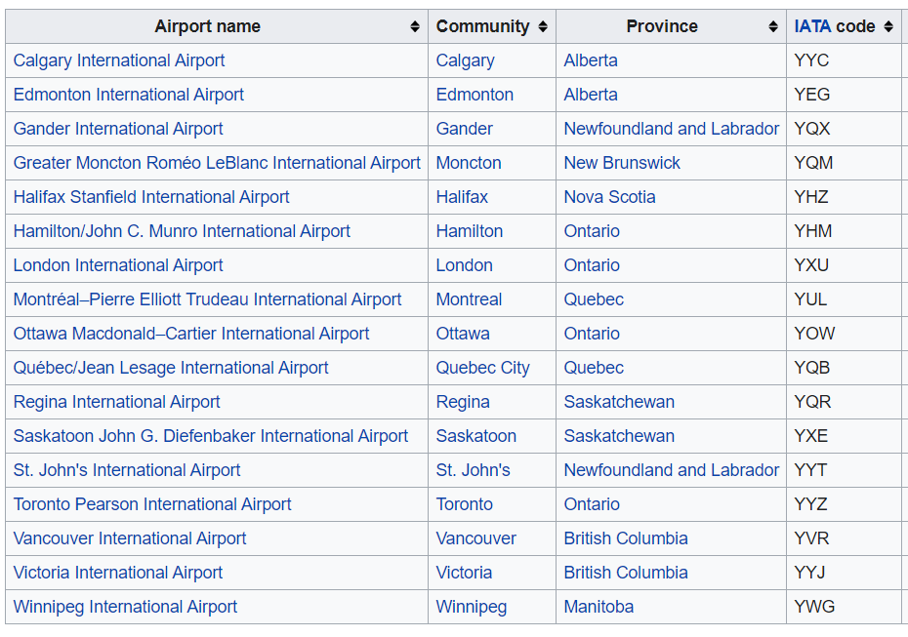
Canada added a Y before the two letter call sign to indicate ‘yes’ (or W for without): UL -> YUL This explains why all Canadian IATA airport codes start with Y.

Slide 6
Clockwise (15 Qs)

Slide 7
Emperor Dom Pedro II of X wanted to improve the agricultural productivity of his country in the mid-late 19th Century, feeling that it was a long way behind Western nations. To do so, he came up with a policy where he encouraged immigration of particular people from a country, believing they would find conditions in X favorable and more in tune with their lifestyle and desires.
10 - 20k people took up his invitation and settled down in X. Every year to date they celebrate a festival Festa _________ with traditional symbols that attract little attention in X, but would be controversial in their country of origin. Who did Dom Pedro II encourage to immigrate (5), and why did he think they would take him up (5)?
1

Slide 8
Answer is. . .

Slide 9

X = Brazil
The people were former citizens of the Confederacy in the U.S. Dom Pedro II believed they would be interested since slavery had not been abolished in Brazil

Slide 10
Billed as the answer to the Nazi-driven Berlin Olympics, there was a left wing Olympics called the People’s Olympiad in the same year, with athletes from liberal and left-leaning nations scheduled to take part. The event was supposed to take place in July 1936, ending days before the start of the Olympics in Berlin.
However, a few days before it was supposed to kick off, the event had to be hastily cancelled. Many of the athletes never made it to the venue, and those that did left quickly. However, some 200 athletes decided to stay back, and do something else given the moment. What was the host city (5), and what did these 200 athletes do (5)?
2

Slide 11
Answer is. . .

Slide 12
Barcelona
Joined the resistance against Franco in the Spanish Civil War

Slide 13
Baron Pierre de Coubertin has generally claimed authorship for the modern pentathlon, which combines fencing, swimming, horse riding, shooting and running. He created the contest to simulate the experience of a 19th-century cavalry soldier behind enemy lines, believing that it would mould an ideal athlete, or a functional soldier.
To make the competition as close to real-life battle as possible, the rules of one of the disciplines specifies something unusual. It is believed that this is a nod to the pentathlon’s military inspiration, and would prepare the athlete for the unexpected - much like a soldier in war. Which discipline, and what is the unusual specification in the rules? (10)
3

Slide 14
Answer is. . .

Slide 15
For the horse riding competition - the athletes are not allowed to use their own horse
They are paired with a random horse 20 minutes before the event starts

Slide 16
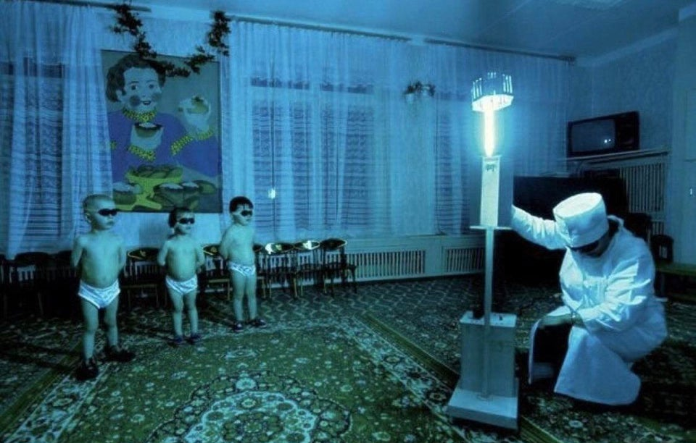
This is a photograph of young children in Siberia. What is going on in the photo (5), and why are the children made to participate in it (5)?
4

Slide 17
Answer is. . .

Slide 18
They are standing in front of UV lamp to get UV light exposure This is done during the long, dark winter months to give them exposure to Vitamin D to help them strengthen their bones

Slide 19
This musical (video) is based on a U.S. youth-led strike campaign to change practices for workers in a certain profession. The main adversaries of the strike campaign were X and Y, often rivals, but who this time worked together to the detriment of the workers. ID X & Y (5). X & Y were also responsible for a corrosive strategy which worried civil liberties advocates. In response, Samuel Warren & Louis Brandeis wrote an article advocating the recognition of a new constitutional right. The article has been prescient for current political debates. In 2017, the Indian Supreme Court issued a landmark judgment effectuating their advocacy. What did Brandeis & Warren advocate for (5)?
5

Slide 20
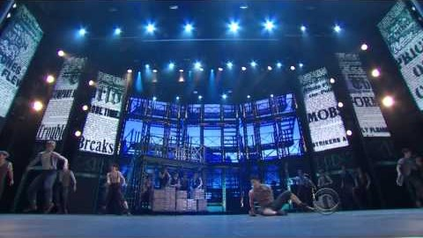
5

Slide 21
Answer is. . .

Slide 22
X & Y = Joseph Pulitzer & William Randolph Hearst
Warren & Brandeis advocated for recognizing a constitutional right to privacy (which they phrased as the right to be left alone)

Slide 23
The next slide, from 1954, shows a process that workers in a certain profession/industry had to undergo on an almost daily basis. Since then, it has been regarded as one of the worst occupational hazards in history.
It was instituted by their employer not for health and safety reasons, but rather for the economic benefit of the employer, to crack down on employee deception leading to lost profits.
What was the profession of these workers (5), and what was the deception employers wanted to crack down on (5)?
6

Slide 24
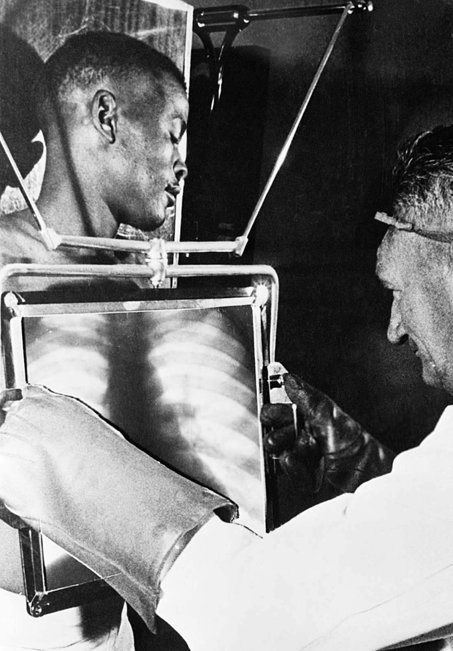
6
What was the profession of these workers (5),
and what was the deception employers wanted to crack down on (5)?

Slide 25
Answer is. . .

Slide 26
Diamond mine workers in South Africa
At the end of each shift, the miners would have to go through the x-ray machine for inspection, since some miners would try to smuggle diamonds out with them. Some, for example, would swallow diamonds, even hide them in self-inflicted incisions in their legs.
They were scanned using a fluoroscope. Fluoroscopic procedures pose a potential for increasing the patient’s risk of radiation-induced cancer (the radiologist gets a dose of radiation as well).

Slide 27
In the 1990s, Sunil Gavaskar and Alvin Kallicharan expressed a desire to serve X, but didn’t know how to do so. X told them to arrange an cricket match. One challenge was finding an appropriate venue. X insisted the match occur at Y, to enable rural cricket enthusiasts to watch a match. However, Y did not have the requisite infrastructure - including a cricket pitch - to host the game. But these challenges were overcome, especially with the support of sponsors who had built a lot of existing infrastructure at Y. Befitting the occasion, the stadium at Y was informally nicknamed by some as ______, after a famous cricket venue. ID Y (5) and nickname (5).
7

Slide 28
Answer is. . .

Slide 29
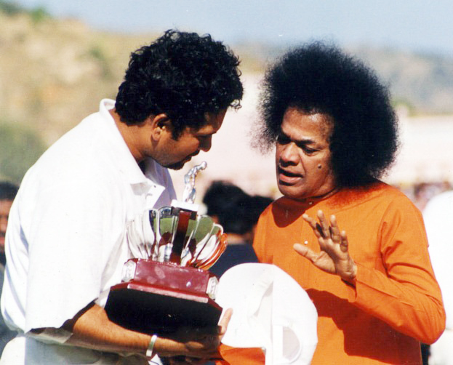
Y = Puttaparthi (where Sathya Sai Baba’s ashram is located)
Nickname was Lords

Slide 30
The painting Shadows of Liberty by Titus Kaphar depicts a proud George Washington on horseback, wielding a sword and demonstrating his authority.
In research for the painting, Kaphar was struck by a certain document he found. He decided to paint the document, and then cut it up into little strips. These strips were then nailed to Washington’s body in the painting. Kaphar wanted to unite two narratives of George Washington, and give prominence to the document, which is often forgotten. What is this document that Kaphar festooned to the painting? (10)
8

Slide 31
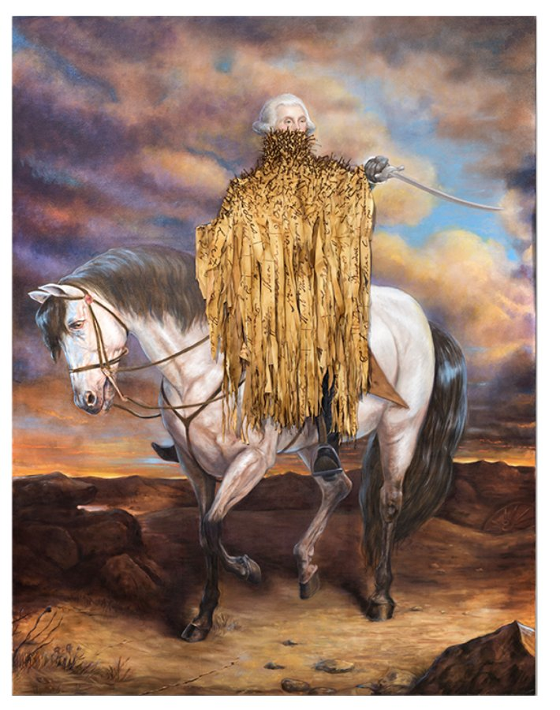
8
What is this document that Kaphar festooned to the painting? (10)

Slide 32
Answer is. . .

Slide 33
George Washington’s slave ledgers

Slide 34
This company began in the 1920s as a collaboration to improve U.S. agricultural output. At the time, boll weevil insects were devastating cotton crops, and posed a threat to the Southern economy.
In 1925, they began to expand and needed new employees. They famously made an offer to X for $2400/year, but X turned them down in favor of a gig in a circus (of sorts). When the company expanded to Peru, they realized that the market for their service was larger than agriculture. They changed their name to reflect a geopraphical feature, and have remained a leading player in an adjacent business line since. What is the company (5), and ID X (5).
9

Slide 35
Answer is. . .

Slide 36
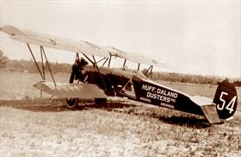
Delta Airlines, which began as Huff-Daland dusters
X = Charles Lindbergh

Slide 37
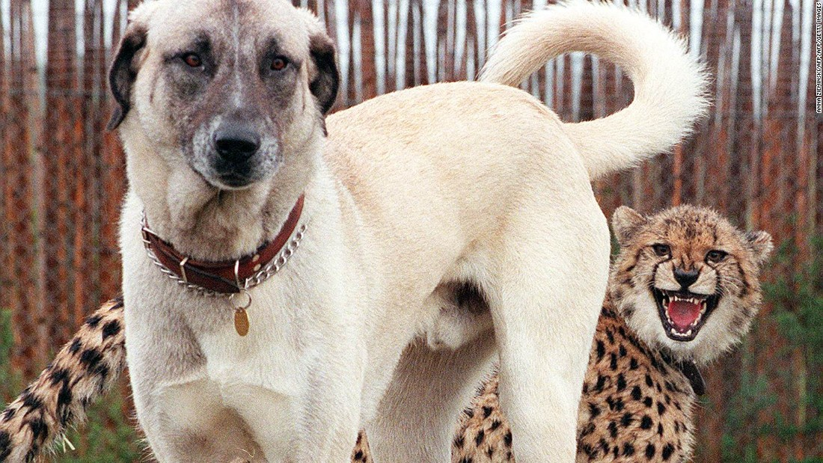
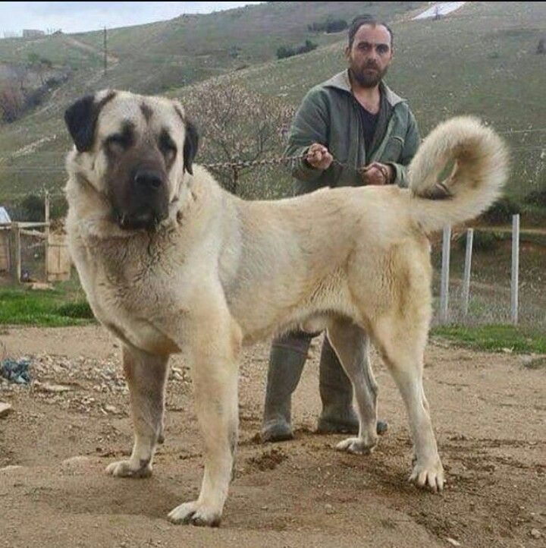
10

Slide 38
In the past decade, in order to protect cheetahs in the wild, the Cheetah Conservation Fund began breeding Kangal dogs in Namibia. Once fully grown, the dog is known for its large size & aggressive bark.
When the dogs are pups, they are given to members of a certain profession, who integrate them into their daily routines. This program has helped alter behaviors in the profession. In the process, it eliminated a threat to the cheetah population that was responsible for ~1000 cheetah deaths annually, all while promoting economic development of the area: a rare win-win.
Members of which profession received these dogs (5), and why was the program successful in eliminating the threat to cheetahs? (5)
10

Slide 39
Answer is. . .

Slide 40
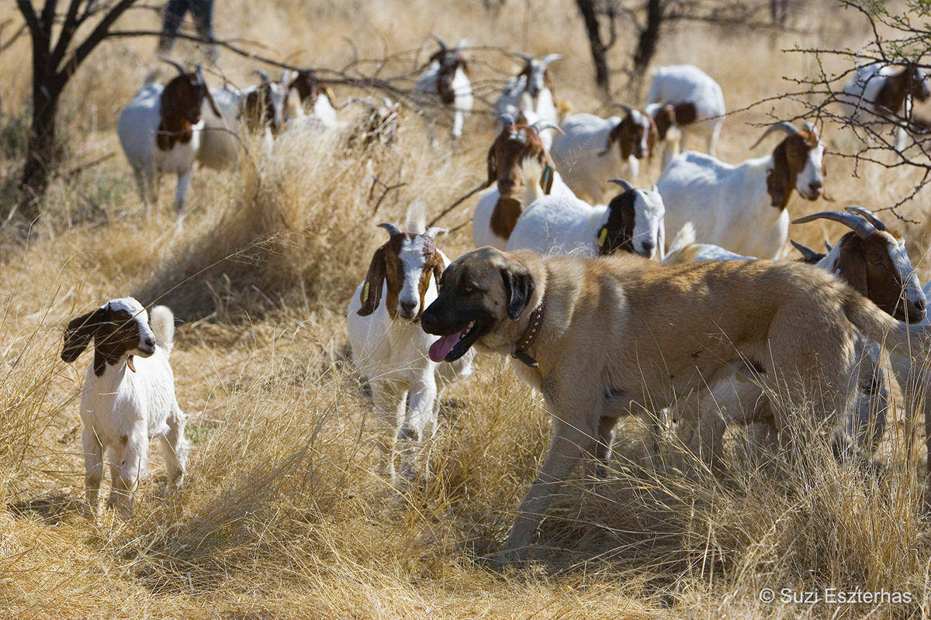
The dogs were given to livestock farmers. In the past, cheetahs would come onto farms to try and hunt sheep and goats. Farmers would then end up having to kill cheetahs to save their livestock.
The cheetah, however, is afraid of the dog’s bark, and stays away from farms patrolled by Kangals - giving non-lethal predator control.

Slide 41

This flag, adopted in 1966, is one of the few flags to not use Pan-African colors. The blue represents a particular resource. However, unlike most flags, which reflect resources abundant in the country, the blue signifies a resource that is sparse in this country, on account of its topography. The country’s motto also alludes to this resource. What resource (5)? The flag also pays tribute to its national animal, which was chosen to advance a particular message. This message was in deliberate contrast to another African country. What was the message (5)?
11

Slide 42
Answer is. . .

Slide 43
The resource is rainwater. It alludes to the motto featured on the coat of arms of Botswana—Pula, which means "Let there be rain" in Setswana. Botswana suffers from dry and arid climate due to the Kalahari desert The black band represents the represent the stripes of the zebra, the national animal of Botswana. The zebra was chosen since its black and white stripes were thought to symbolize harmony and cooperation between people of different races – a contrast to South Africa, which still maintained the Apartheid regime

Slide 44
In May 1946, Oxford University’s Majlis society organized a special dinner, the last time someone would host a dinner for X. Organizing this dinner was rather challenging, with the biggest challenge being the menu that most restaurants would have refused to do. Eventually they managed to get the Angel Restaurant to agree, although quite how they did so is not known – and likely involved extensive persuasion. Why was this the last time a dinner for X would happen (5), and why would most restaurants have refused to host (5)?
12

Slide 45
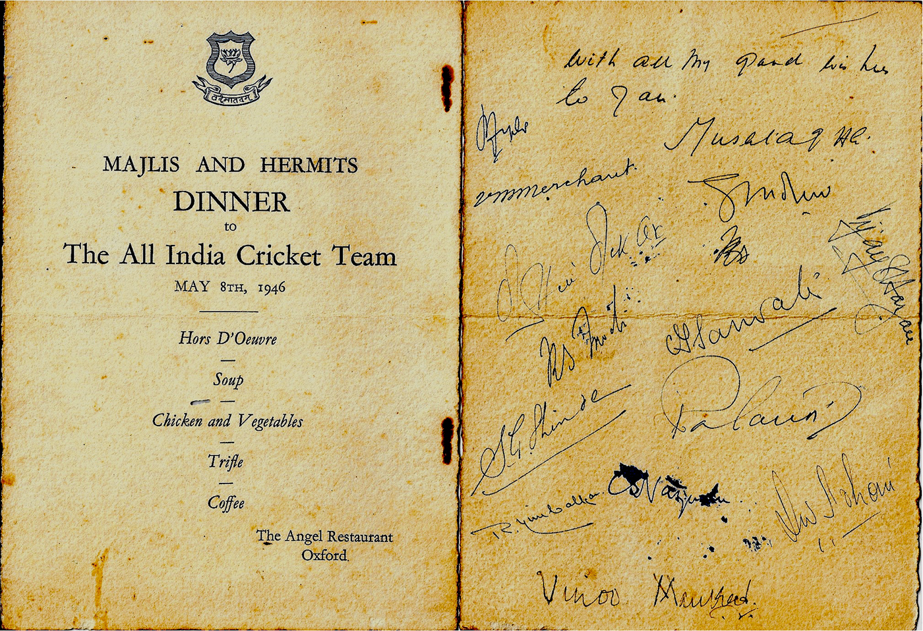
12

Slide 46
Answer is. . .

Slide 47
X was the All India Cricket Team (included players from both India & Pakistan). This was the last series they took part in pre-partition. The dinner was a challenge because of the rationing during and after World War II – in order to ensure that even restaurants complied, the price that restaurants could charge was set, and they were usually not allowed to serve more than 3 course meals

Slide 48
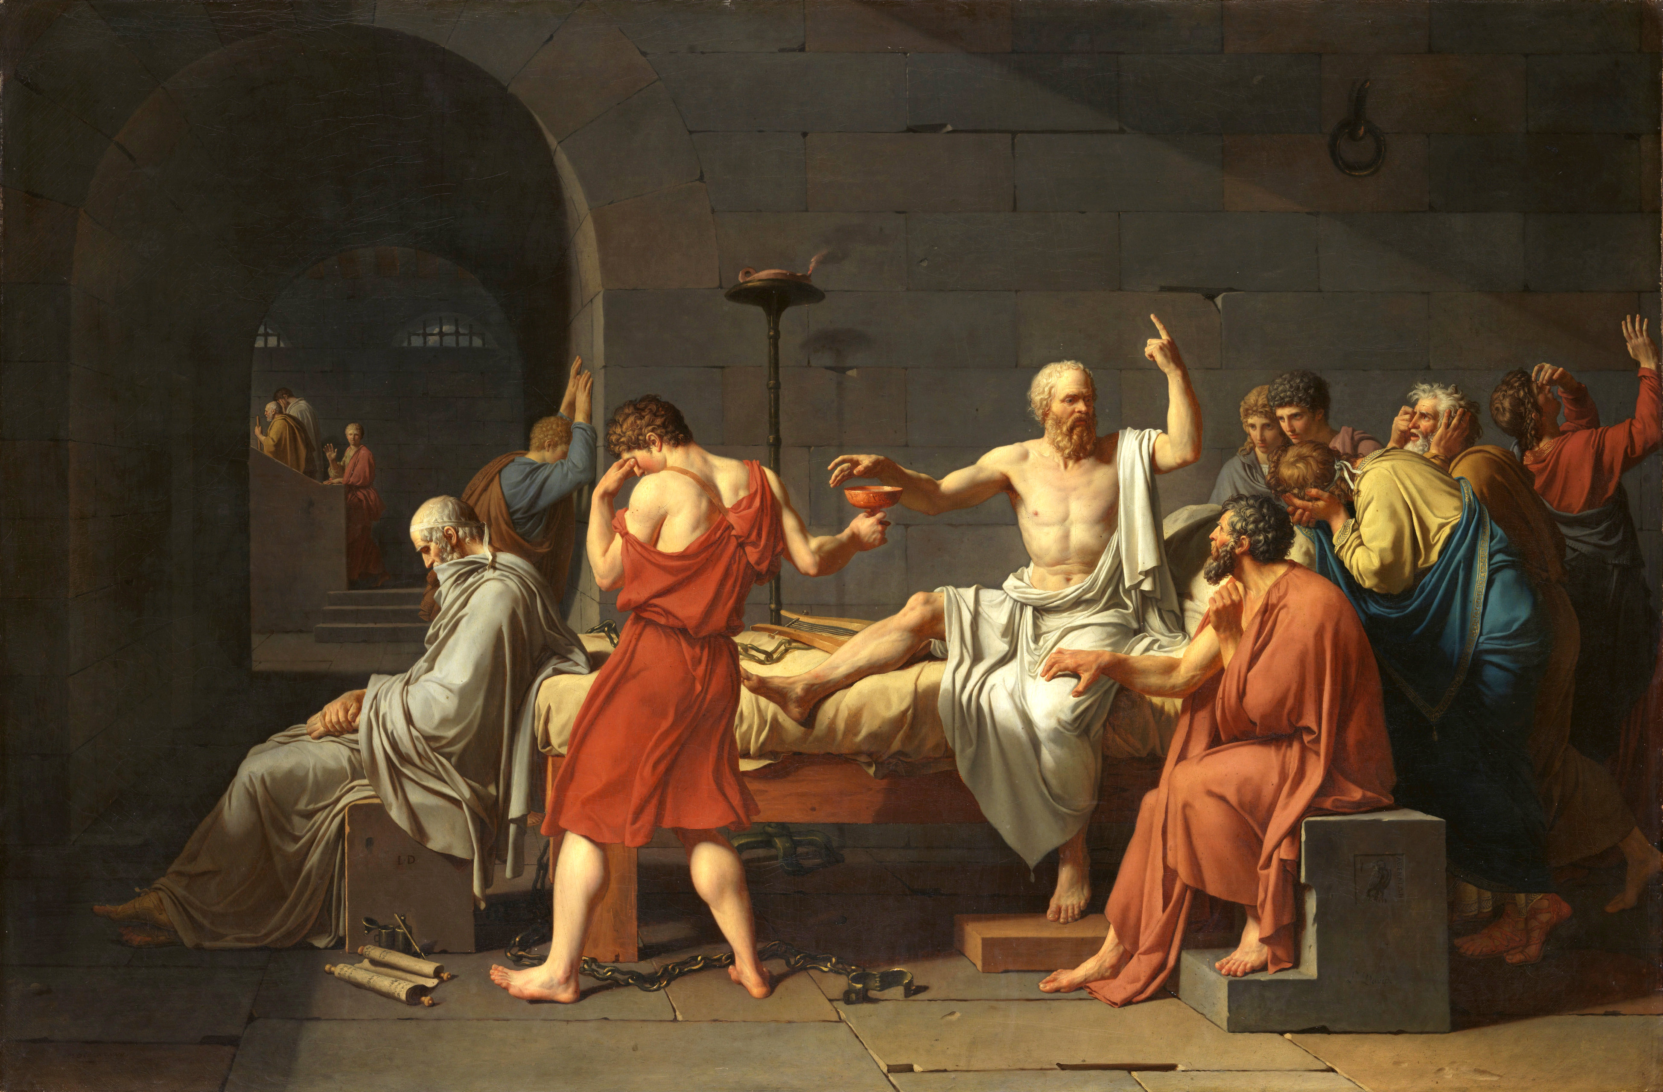
13
X

Slide 49
The painting on the previous slide by Jacques-Louis David memorializes an important real-life historical moment from 399 BCE. David, however, breaks with certain facts in his painting, most notably as relates to the protagonist (in the centre). Another change is the addition of X, who was not present at the event, and is made to look much older than he was at the time. Perhaps David did this because X went on to provide the most definitive account of this event. Art historians also say that David likely made one addition to the work to pay tribute to X. This was a citation of sorts, as X provided the source material. ID X (5) and what did David do to pay tribute to X (5)?
13

Slide 50
Answer is. . .

Slide 51
The event is Death of Socrates X = Plato, whose work Phaedo provides the most detailed account of the last hours of Socrates’ life David usually includes his signature with last name on his paintings proximate to the character he most identified with (if one) (in this painting – Crito). But in this case, he added a second signature of just his initials (L.D) near Plato’s character

Slide 52
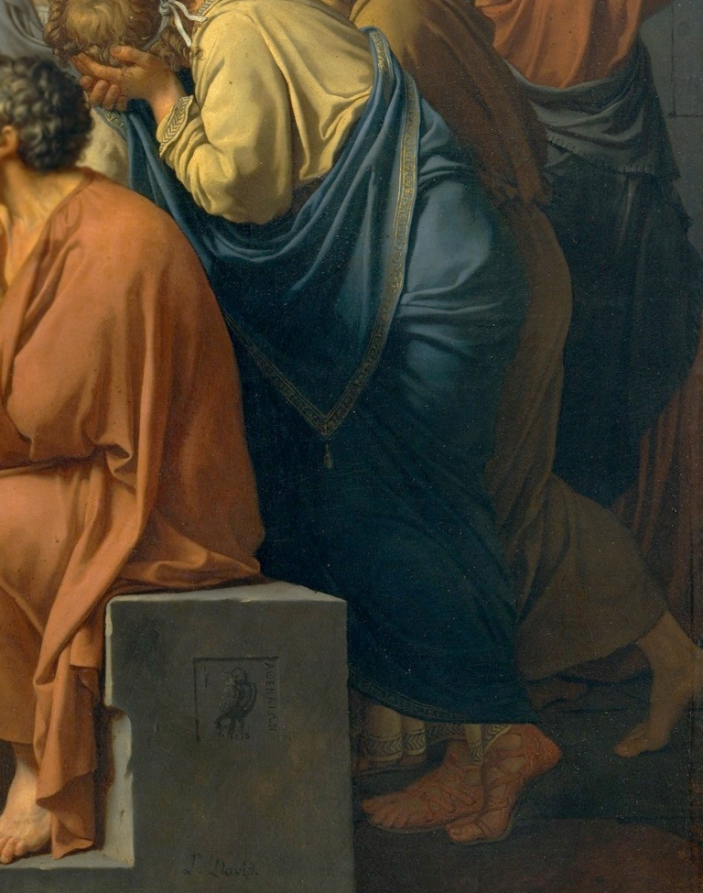
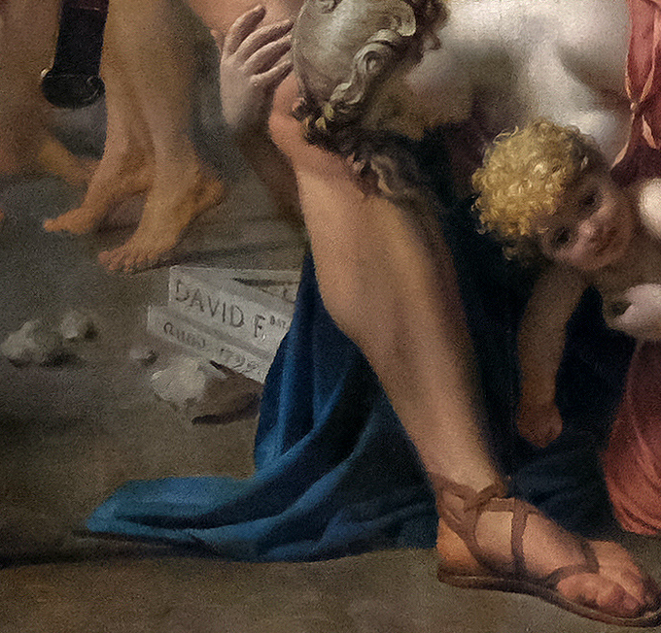

Slide 53
Guinot is a French cosmetics company known for its pioneering approach to tennis sponsorship. Their sponsorship efforts are aimed at Grand Slams, where they tend to sponsor 8-10 players per Slam. However, unlike most companies, they do not traditionally have a fixed roster of players they sponsor. Rather, they are known for spur-of-the-moment endorsement deals. Many of those that they approach are very keen, and it offers a path to cheap publicity for Guinot. Guinot is usually less busy in Week 2 of the Slams, although they occasionally continue their sponsorships(as they did with the Men’s Singles at French Open 2018). What is Guinot’s rather unique marketing strategy (10)?
14

Slide 54
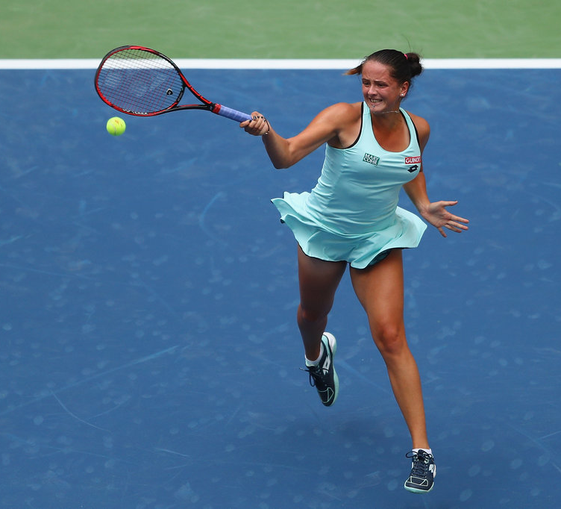
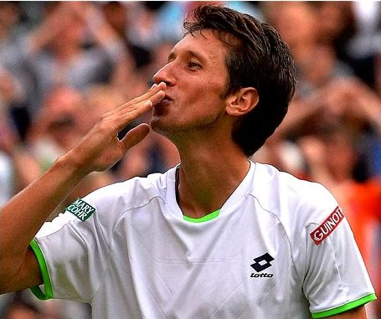
14

Slide 55

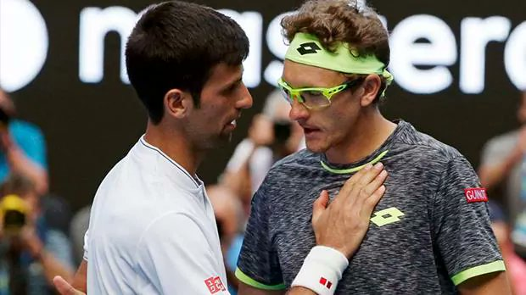
Guinot tends to sponsor low seed/unseeded players who are drawn to play top seeds on the show courts at Grand Slams. The sponsorships usually are on a match-by-match basis, and can be renewed if players progress deep (such as Marco Cecchinato did in French Open 2018) They have also occasionally sponsored lower seeded players who surprised the field to win the Slam (such as Marion Bartoli, Sam Stosur and Svetlana Kuznetsova)

Slide 56
In the 1950s, eleven people from Gallaudet College – a university for the deaf and hard of hearing –volunteered for a decade-long study conducted by the U.S. Naval School of Medicine & X. Most had suffered from spinal meningitis, which left them deaf from a young age. The study tested their balance and physiological adaptations in a range of environments. The Gallaudet Eleven reported no adverse effects and some even enjoyed the experience. As one volunteer said, “We were different in a way they needed.” Because of the Gallaudet Eleven, researchers gained a deeper insight of the human body – they were thus invaluable to the course of history. Why were the Gallaudet Eleven specifically chosen for this study (10)?
15

Slide 57
Answer is. . .

Slide 58
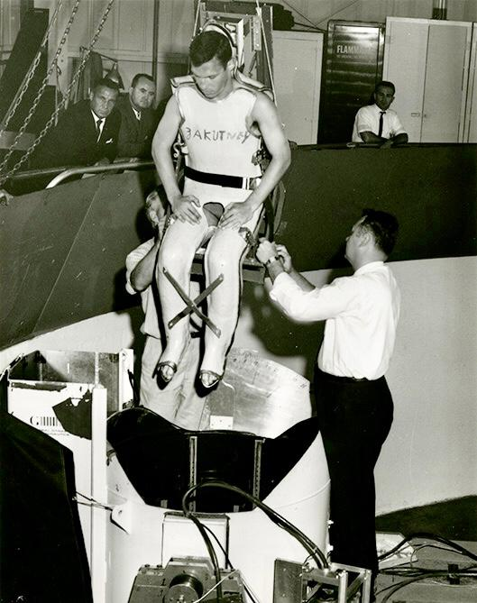
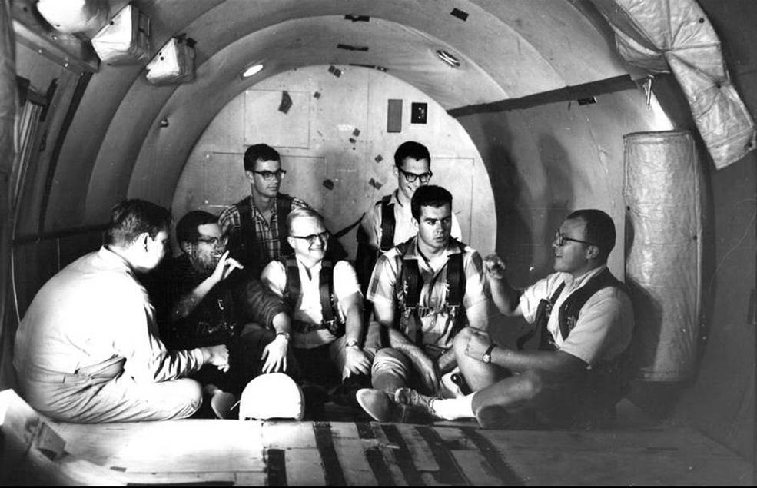
The research study was to help to improve understanding of how the body’s sensory systems work when the usual gravitational cues from the inner ear aren't available – which would be the case during spaceflight, but was also the case for the Gallaudet Eleven

Slide 59
Anti-clockwise (15 Qs)

Slide 60
The image shows Japanese honeybees protecting themselves against a dangerous predator with a deadly name. The honeybee defense mechanism is unique. When hunting, the predator emits a pheromonal signal. Honeybees detect this signal and, counter-intuitively, draw the predator into the hive, giving away their location. When the predator enters the hive, the honeybees ambush it, and execute a “brutal but satisfying” form of self-defense. The bees violently vibrate their flight muscles, mimicking behavior they perform every winter. This mode of self-defense cannot be accomplished outside the hive. ID the predator (5), and how does this ambush mechanism work (5)?
16

Slide 61
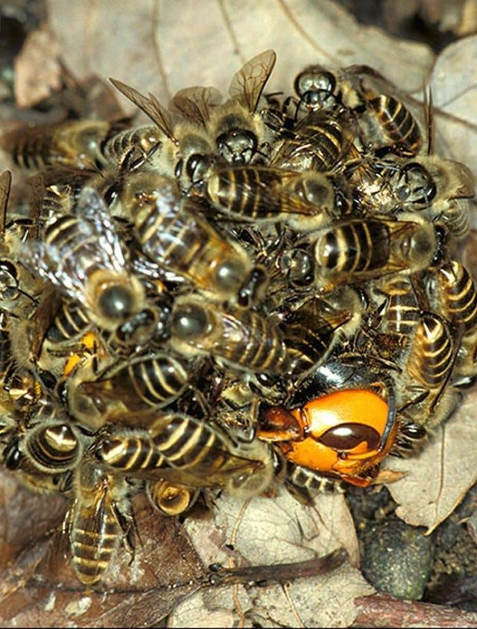
16

Slide 62
Answer is. . .

Slide 63
Predator is murder hornets (or Japanese/Asian Giant Hornet) The violent vibration of their flight muscles raises the temperature in the ball surrounding the hornet to the critical temperature of 46 °C. In addition, the exertions of the honeybees raise the level of carbon dioxide in the ball. The hornet cannot survive the combination of high temperature and high carbon dioxide level and dies. The ambush is conducted inside the hive since by killing the hornet scout, they prevent it from summoning reinforcements that would wipe out the entire colony

Slide 64
In 1878, an erstwhile reporter was secretly engaged for 7 years to set up the colonial Congo Free State on behalf of the Belgian King Leopold, because of their previous experiences on the continent. Who (5)? After discovering this movement, French intelligence dispatched an Italian born explorer in 1881 to stake a French claim on the opposite bank of the Congo basin. What was their name (and/or What did they lend their name to) (5)?
17

Slide 65
Answer is. . .

Slide 66
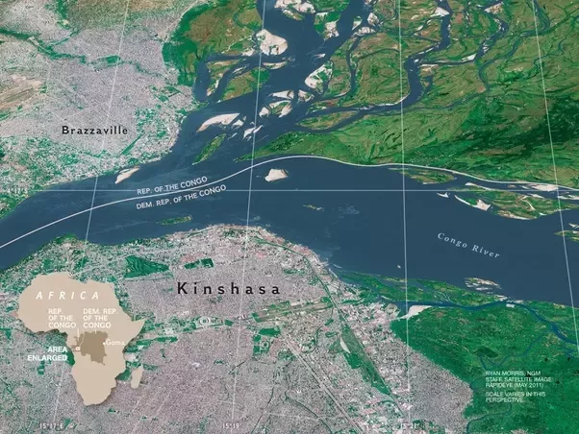
Henry Morton Stanley, famous for earlier finding Dr. Livingstone. Pierre de Brazza, who lent his name to Brazzaville on the west bank of the Congo river. Stanley had earlier founded Leopoldville (now Kinshasa) on the east bank of the river.

Slide 67
Until an administrative change in 46 BCE, the office of pontifex maximus (chief priest) in ancient Rome was empowered to use a mechanism called Mercedonius. In theory, pontiffs was supposed to use this power to ensure that the lives of citizens were aligned with the natural world and the seasons. But they were usually politicians as well, and more often wielded it to achieve nefarious aims, like keeping allies in office longer or forcing out enemies earlier. What is Mercedonius (5)? And what mechanism, introduced by the change made in 46 BCE, replaced it (5)?
18

Slide 68
Answer is. . .

Slide 69
An intercalary period to align the calendar with the earth’s revolution around the sun. The pontifex maximus had to power to add this period whenever they wanted to. Mercedonius means ‘work month’ in Latin. Leap years were introduced when the Julian calendar was enforced after 46 BCE.

Slide 70
Many spices in this iconic food item - like cardamom, star anise, and cumin - are not indigenous to the country it is associated with. They were likely brought in by traders from the Indian subcontinent and Middle East. These spices are combined with local produce, like galangal and shrimp paste, to yield a rich paste. Reflecting its origin, the dish is prepared only sparingly with pork. What food item (5)? Why did the name come about (5)?
19

Slide 71
Answer is. . .

Slide 72

Massaman curry Massaman is a Thai corruption of Mussalman - the traders who brought the spices in were Muslim

Slide 73
Lewis Carroll was a pen name for Reverend Charles Dodgson, a deeply conservative and traditionalist mathematician at Oxford. His famous Alice works were intended to be allegories for his views on mathematics and philosophy. This scene in Alice in Wonderland is his rebuke to contemporary developments in mathematics, pioneered by Euler and Gauss, that broke with rules & structures that Dodgson saw as fundamental. What development in maths was this scene responding to (10)?
20

Slide 74
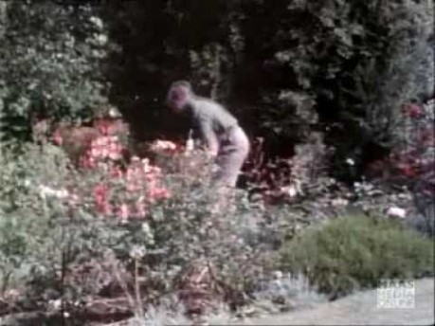
The Hatter opened his eyes very wide on hearing this; but all he said was, `Why is a raven like a writing-desk?’ [. . .] `Do you mean that you think you can find out the answer to it?' said the March Hare. `Exactly so,' said Alice. `Then you should say what you mean,' the March Hare went on. `I do,' Alice hastily replied; `at least--at least I mean what I say--that's the same thing, you know.’ `Not the same thing a bit!' said the Hatter. `You might just as well say that "I see what I eat" is the same thing as "I eat what I see"!
20

Slide 75
Answer is. . .

Slide 76
Complex/imaginary numbers - in particular, quaternions, which is a 4D imaginary number system used today in computations involving rotations: your phone almost certainly uses quaternion computation to calculate its orientation. ‘Why is a raven like a writing-desk?’ refers to Dodgson’s belief that imaginary numbers were an absurd proposition. The shifting table arrangements in the scene (not in the video) refers to what he saw as the chaotic nature of complex number multiplication. ‘“I see what I eat” is the same thing as “I eat what I see”!’ refers to the fact that quaternion multiplication is not commutative: a*b neq b*a

Slide 77
After Soviet geologists identified this area in current day Turkmenistan as a potential oil field, petroleum engineers in 1971 found that their rigs had instead hit a pocket of natural gas. To their shock, the ground beneath their equipment collapsed on itself, yielding a crater measuring over 70m in diameter and causing a gas leak from the reservoir. What did the engineers do to prevent poisonous gas discharge (5)? What name did local people give to the feature that resulted (5)?
21

Slide 78
Answer is. . .

Slide 79
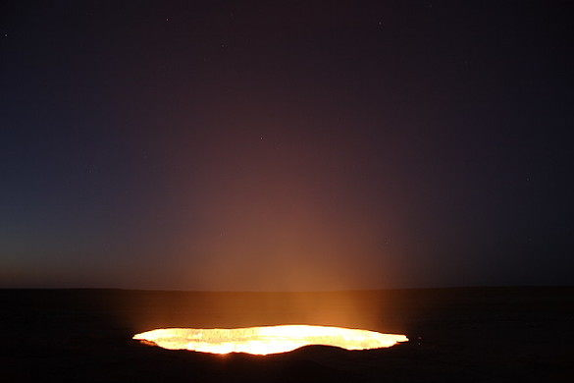
They set fire to the gas, expecting it would extinguish the leak in 2 days. Almost fifty years later, the fire still burns. Known as the Gates of Hell, or less interestingly as the Darwaza Gas Crater.

Slide 80
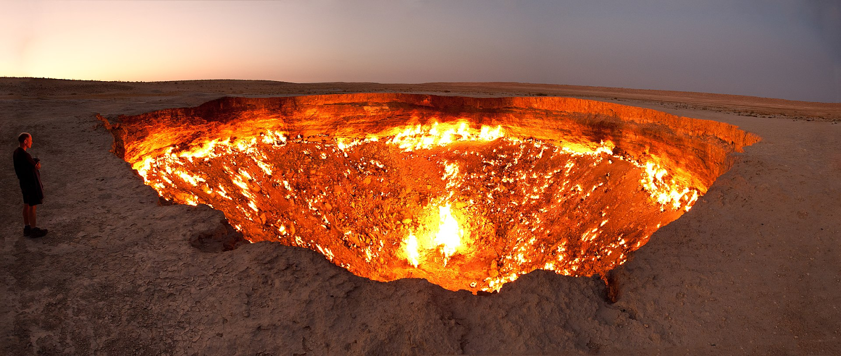

Slide 81
Phosphorus is usually found in soils with large masses of dead microorganisms and is the principal driver of plant fertility in the Amazon basin. However, Amazonian soils by themselves are P deficient because frequent rainfall washes the nutrient away into streams. Through the 2010s, scientists confirmed that this leaching is balanced by an annual migration of dust from a surprising source, which brings about 22,000 tons of P to the region. The discovery also lent credence to another recent theory about the natural history of the source. What is the source of the dust (5)? And what theory (5)?
22

Slide 82
Answer is. . .

Slide 83
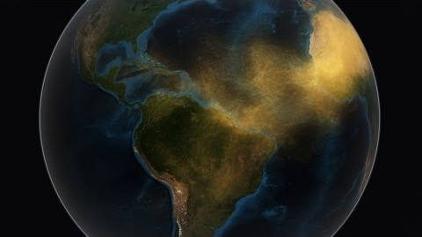
The Sahara Desert The theory was that the Sahara was a lake-bed formed some 250,000 years ago when the Nile River pushed through a low channel near Wadi Tushka. This flooded the eastern Sahara, creating a lake that at its highest level covered more than 42,000 square miles, and is where dead micro-organisms are thought to come from

Slide 84
The name of this writing system references its 16th century use by a religious sect: it means either ‘utterance by the teacher’ or ‘of those who face the teacher’. This contrasts with another script used to transcribe the same language in the opposite direction, whose name evokes royal instead of spiritual decree. What are the names of these two scripts, whose prevalence is now largely determined by a border (10)?
23

Slide 85
Answer is. . .

Slide 86

Gurmukhi and Shahmukhi, now used to write Punjabi in India and Pakistan respectively

Slide 87
This is a prison facility on the erstwhile Isle of Pines. The design is intended to give inmates the feeling that they are under constant surveillance, or at least to never let them know when they are being watched. In this case, a central watchtower overlooks cells in a five storey ring around it. What idea by 18th century philosopher Jeremy Bentham is this design based on (5)? Which pair of political prisoners did the prison hold, both of whom went on to become heads of state in their nation (5)?
24

Slide 88
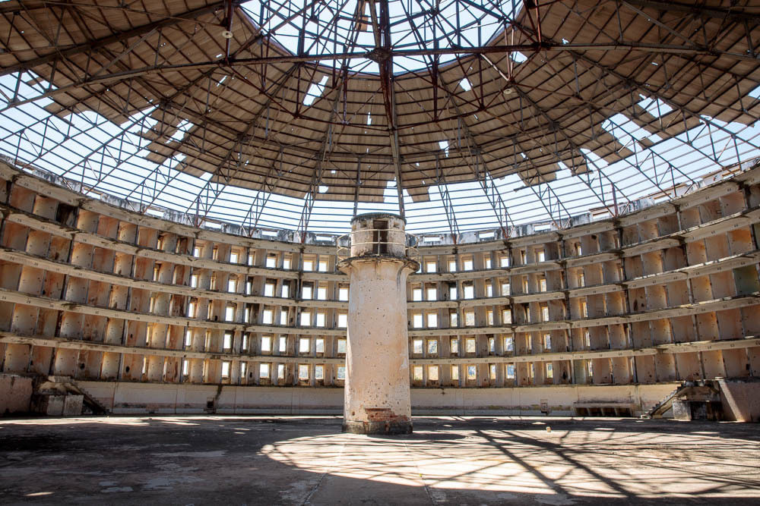
24

Slide 89
Answer is. . .

Slide 90
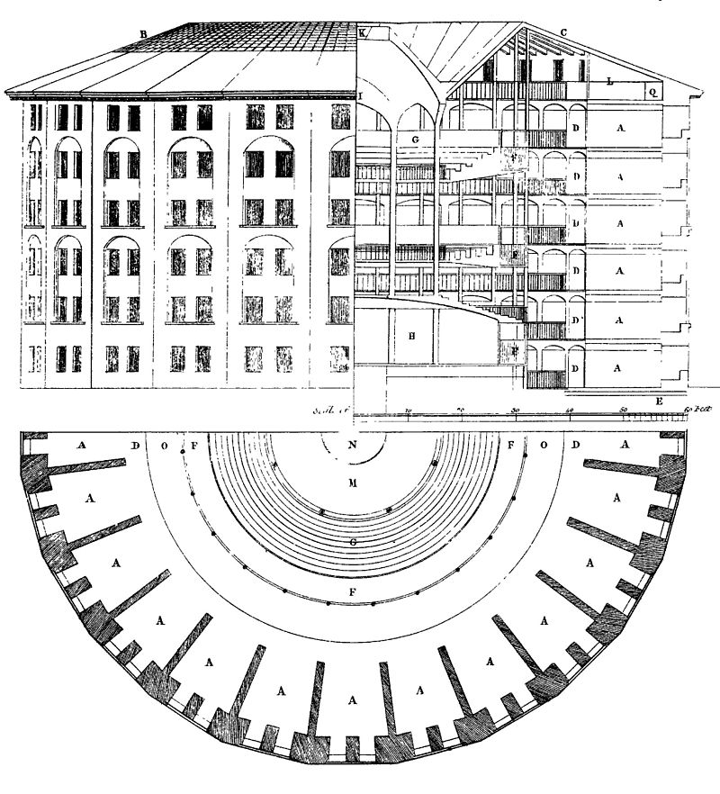
Bentham’s Panopticon – it inspired the prison Presidio Modelo The Castro brothers, Fidel and Raul

Slide 91
In 1937, Gunnar Myrdal was hired by the Carnegie Corporation to lead an inquiry into race relations in the US, which yielded a report titled An American Dilemma. What watershed moment in US history did this report lend support to (5)? Myrdal was a co-recipient of the 1974 Nobel Prize in economics. Both awardees were recognized for studying “the theory of money and economic fluctuations” and “interdependence of economic, social, and institutional phenomena.” But neither recipient was pleased with the arrangement. Who was the other awardee (5)?
25

Slide 92
Answer is. . .

Slide 93
The 1954 SCOTUS ruling on Brown v Board of Education, which held that “separate but equal” racial school segregation was unconstitutional. The report was cited “in general” in support of the majority view. Friedrich Hayek. The two held opposing views on most matters, which is why neither was pleased by the arrangement.

Slide 94
These are pictures of the European Space Agency’s ‘Mars Yard’, a testing environment for their planned 2022 unmanned mission to Mars. The Martian surface is fine grained, powdery and contains high amounts of iron and sodium, while the crust is largely basalt. Where did the ESA procure 150 tons of similar soil from (5), which influenced the ultimate location for the project? What is the purpose of the specialized crane in the background (5)?
26

Slide 95
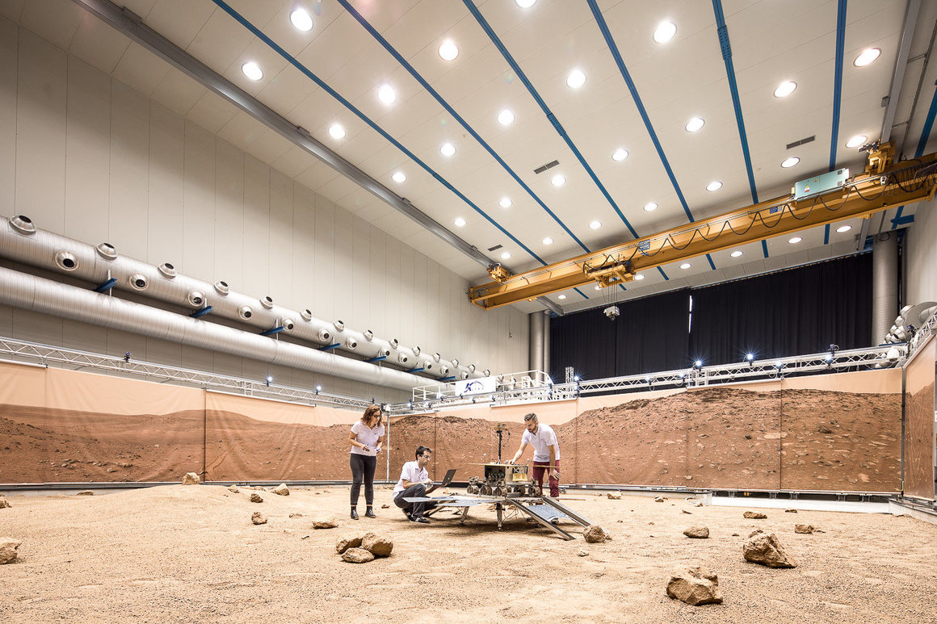
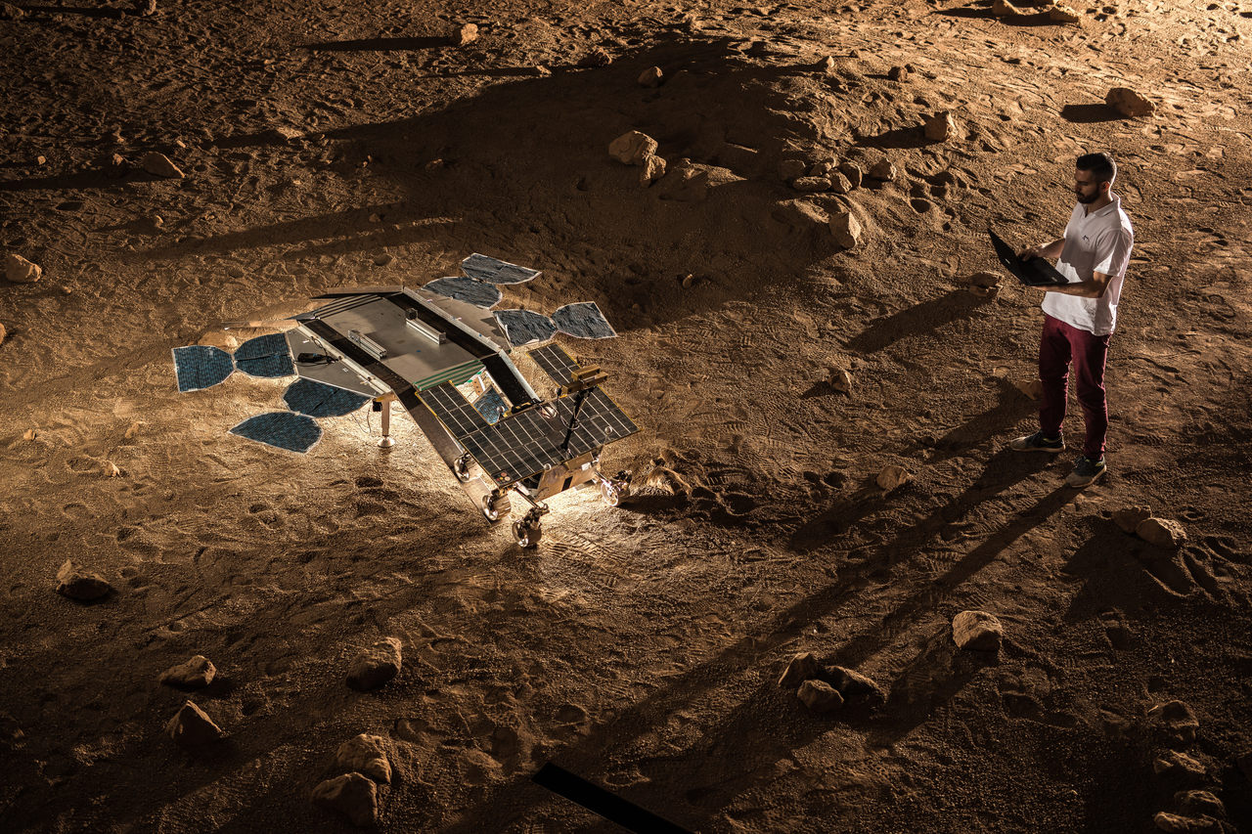
Where did the ESA procure 150 tons of similar soil from (5)?
What is the purpose of the specialized crane in the background (5)?

Slide 96
Answer is. . .

Slide 97
The soils around Mount Vesuvius: basalt is a volcanic rock and the eruption over 2000 years ago threw out soil very similar to Martian soil. This is also why the environment was built in Italy. The crane mechanism is connected to the test rovers and reduces their weight to simulate their motion under Martian gravity.

Slide 98
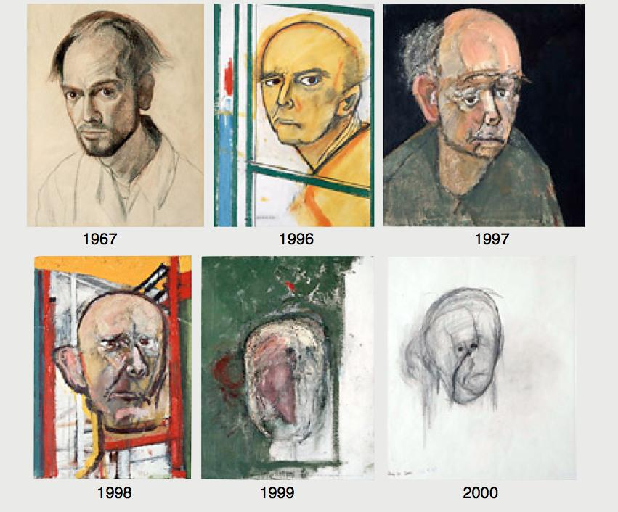
What is the story behind these paintings by artist William Utermohlen (10)?
27

Slide 99
Answer is. . .

Slide 100
Self-portraits of the painter through Alzheimer’s disease / dementia

Slide 101
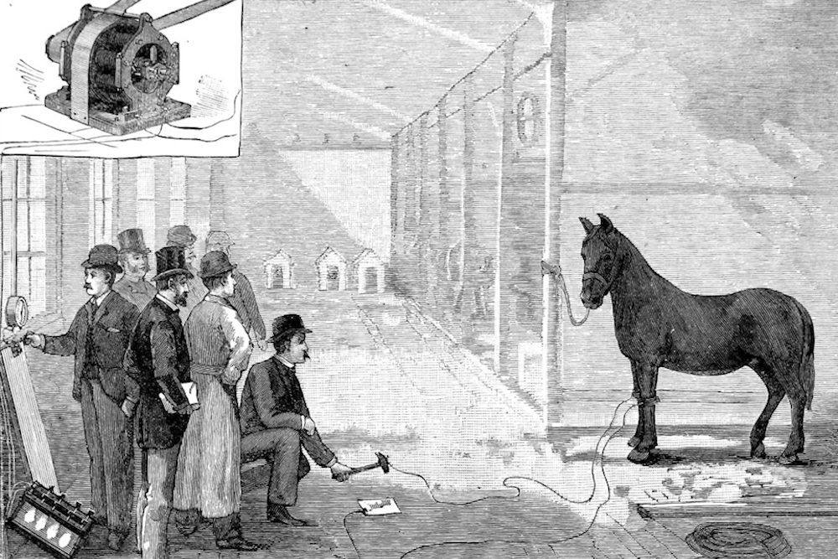
This photo, published in the December 1888 Scientific American, depicts a public experiment led by an engineer named Harold Brown. What invention did a series of similar public demonstrations lead to (5)? What ulterior motive lay behind the invention and these experiments (5)?
28

Slide 102
Answer is. . .

Slide 103
These demonstrations led to the electric chair, which used 1000V alternating current to electrocute people. All of this was part of a smear campaign on AC during the “war of the currents”, fought between Thomas Edison/General Electric (DC) and Westinghouse (AC). Backed by Edison, Harold Brown conducted public experiments around the US where he electrocuted dogs, horses, and apparently even an elephant, using AC. This was done to prove the apparent dangers of using alternating current: the intention was to put off homeowners from using the “executioner’s current”.

Slide 104
In the 1840s, the British East India Company instituted the Inland Customs Line. Initially, the Line was patrolled by 14,000 officers and fortified with large masses of thorny branches. However, this left the fortification susceptible to winds and attacks by ants and locusts. In 1868, the Commissioner of Inland Customs suggested that living trees and shrubs be used instead. This led to the formation of a 2,500 km long hedge across India, which helped the Commissioner pursue his interests as he travelled across the country to ensure the Line was collecting revenue. What was the purpose of the Line (5)? Who called for the live hedge (5)?
29

Slide 105
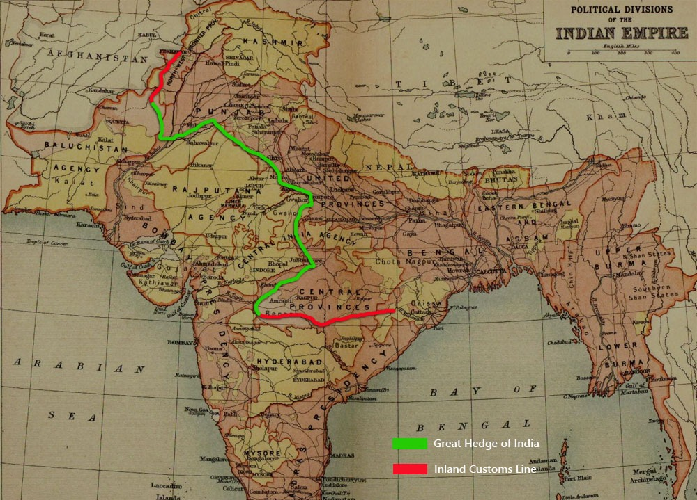
29

Slide 106
Answer is. . .

Slide 107
The purpose of the hedge was to prevent those who produced salt in the West could not sell it in the East, and to enable the British to collect a tax on it The Commissioner was Allan Octavian Hume, who was known for his interests in botany and ornithology

Slide 108
Score update – last Q coming up

Slide 109
The principle behind the Schlieren setup is that transparent phenomena often refract, or bend, a light beam projected through them. These refracted rays then miss a critical focal point in the schlieren system, which can be a simple target - for example, a razor-blade edge - that acts as a spatial filter. The razor blade discriminates refracted from unrefracted light rays, allowing invisible optical phase disturbances to become visible. What social protocol does the setup help provide support for (10)?
30

Slide 110
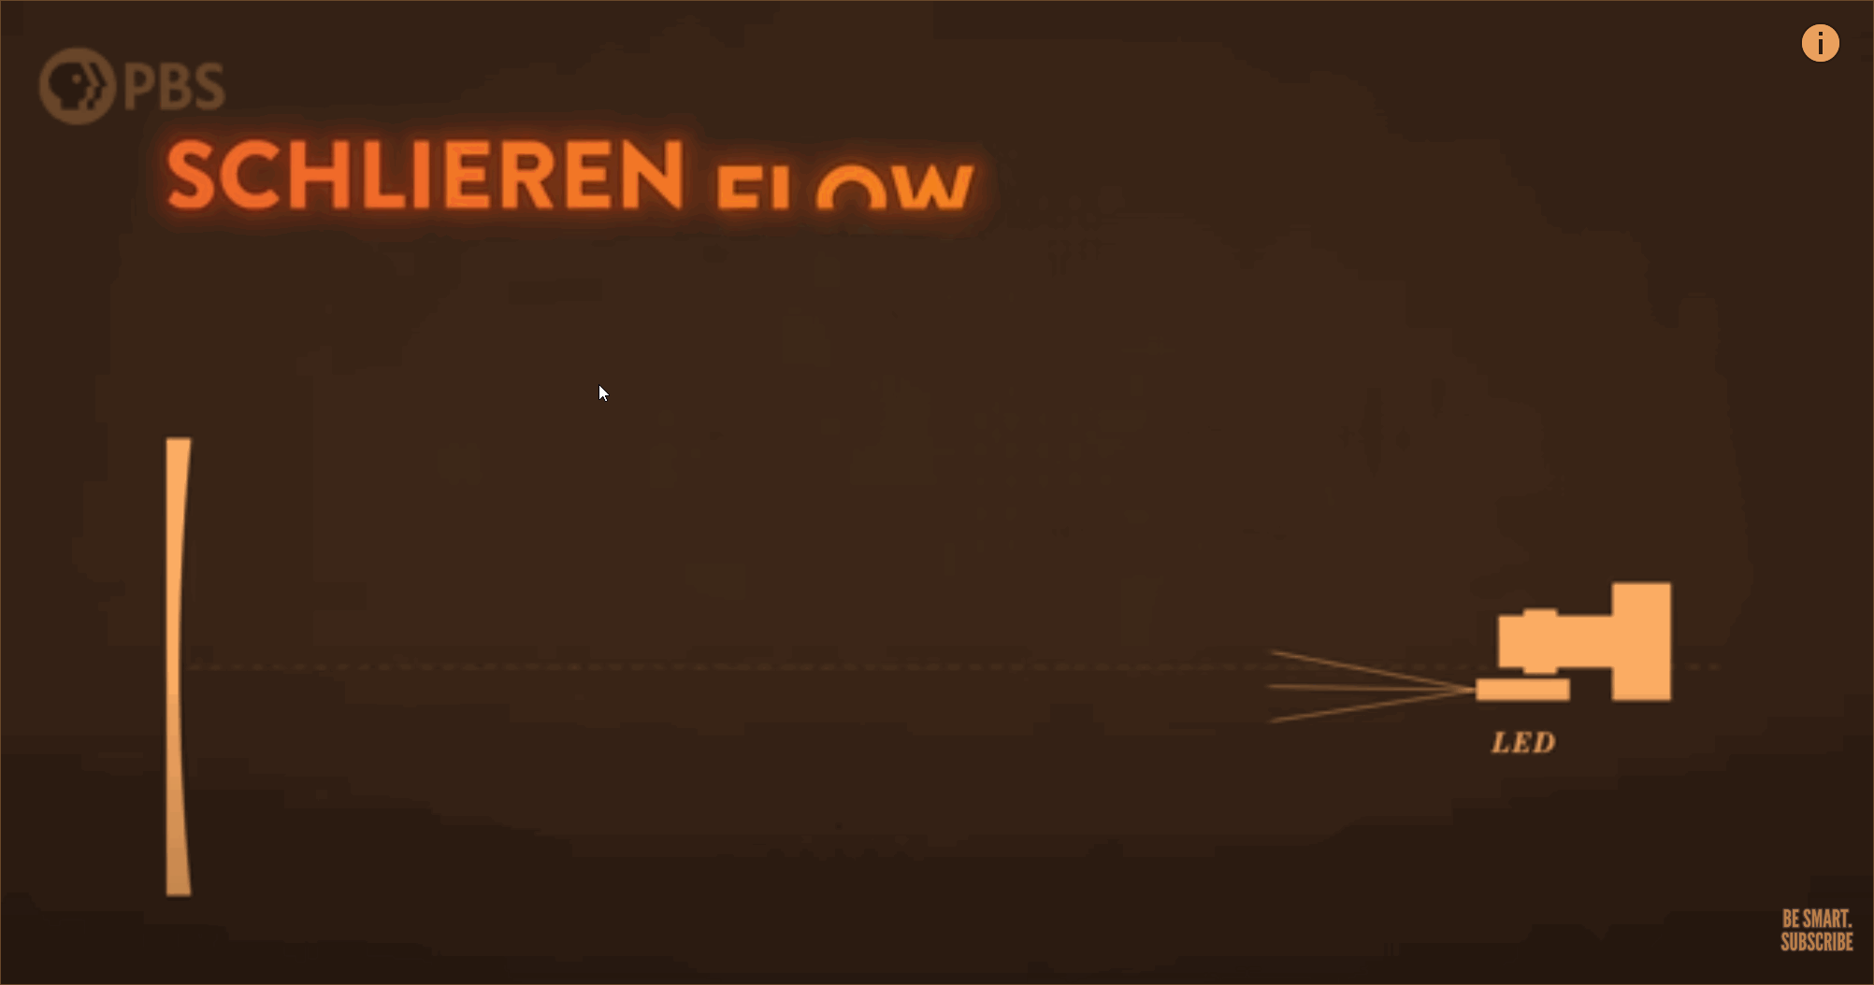
30

Slide 111
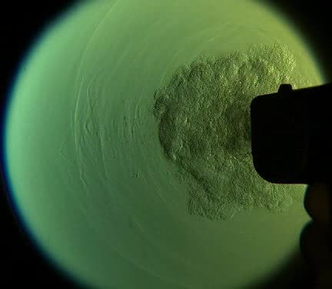
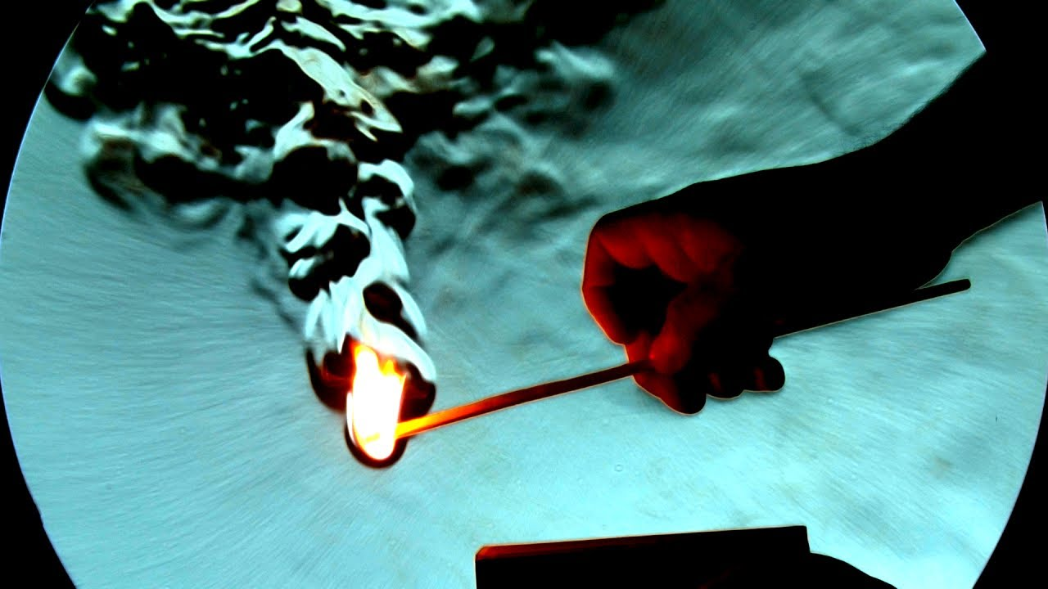
30

Slide 112
Answer is. . .

Slide 113
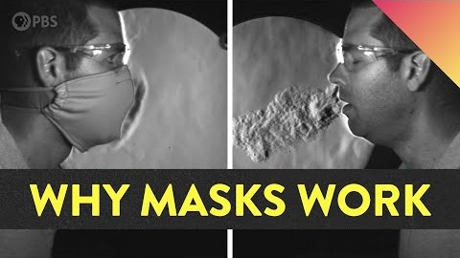

Slide 114
Thank you!

